Slide 1

AJAY KUMAR GARG ENGINEERING COLLEGE
Analyzing the Android Market: Exploratory Data Analysis of Google Playstore Apps
Subject:Mini Project or Internship Assessment (KCS554)
Presented to:
Mr. Updesh Kumar Jaiswal
Assistant Professor,
Department of CSE,
AKGEC, Ghaziabad.
Presented by:
Student Name:Sneha Vasishth
Univ Roll No:2100270130175
Section: CSE3
Group: D

Slide 2
Outline
Introduction to the Android Market
Problem Statement
Technology Used
Datasets
Observations and Analysis
Future Scope
Reference

Slide 3
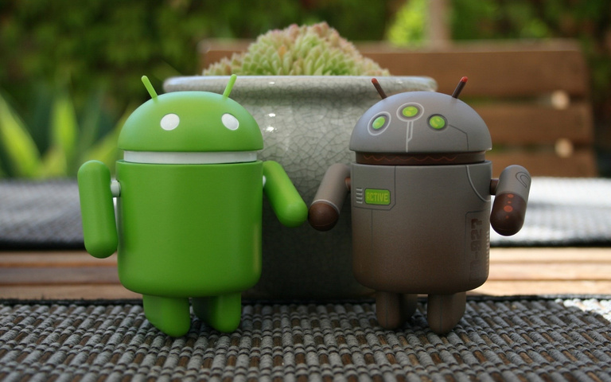
Introduction to Android Market
The Android market, represented by the Google Play Store, offers an extensive array of apps, reflecting its vast diversity and utility. With over 2.5 million apps available, it caters to a wide range of interests and needs. The most prominent categories include "Games," which constitutes a significant portion of the market, alongside "Tools," "Entertainment," "Education," "Productivity," and "Communication" apps. This diversity ensures that users can find applications for entertainment, productivity, communication, and learning, making the Google Play Store a one-stop destination for a multitude of mobile app experiences.

Slide 4

Problem Statement
Description: Today , 1.85 million different apps are available for users to download . Android users have even more from which to choose, with 2.56 million avaialble through the Google Play Store. These apps have come to play a huge role in the way we live our lives today.
This analysis has yielded valuable insights that can offer guidance to mobile app developers, helping them make informed decisions about which categories to focus on for their app development.

Slide 5

Technology Used
Numpy
Pandas
Python
Seaborn
Matplotlib

Slide 6
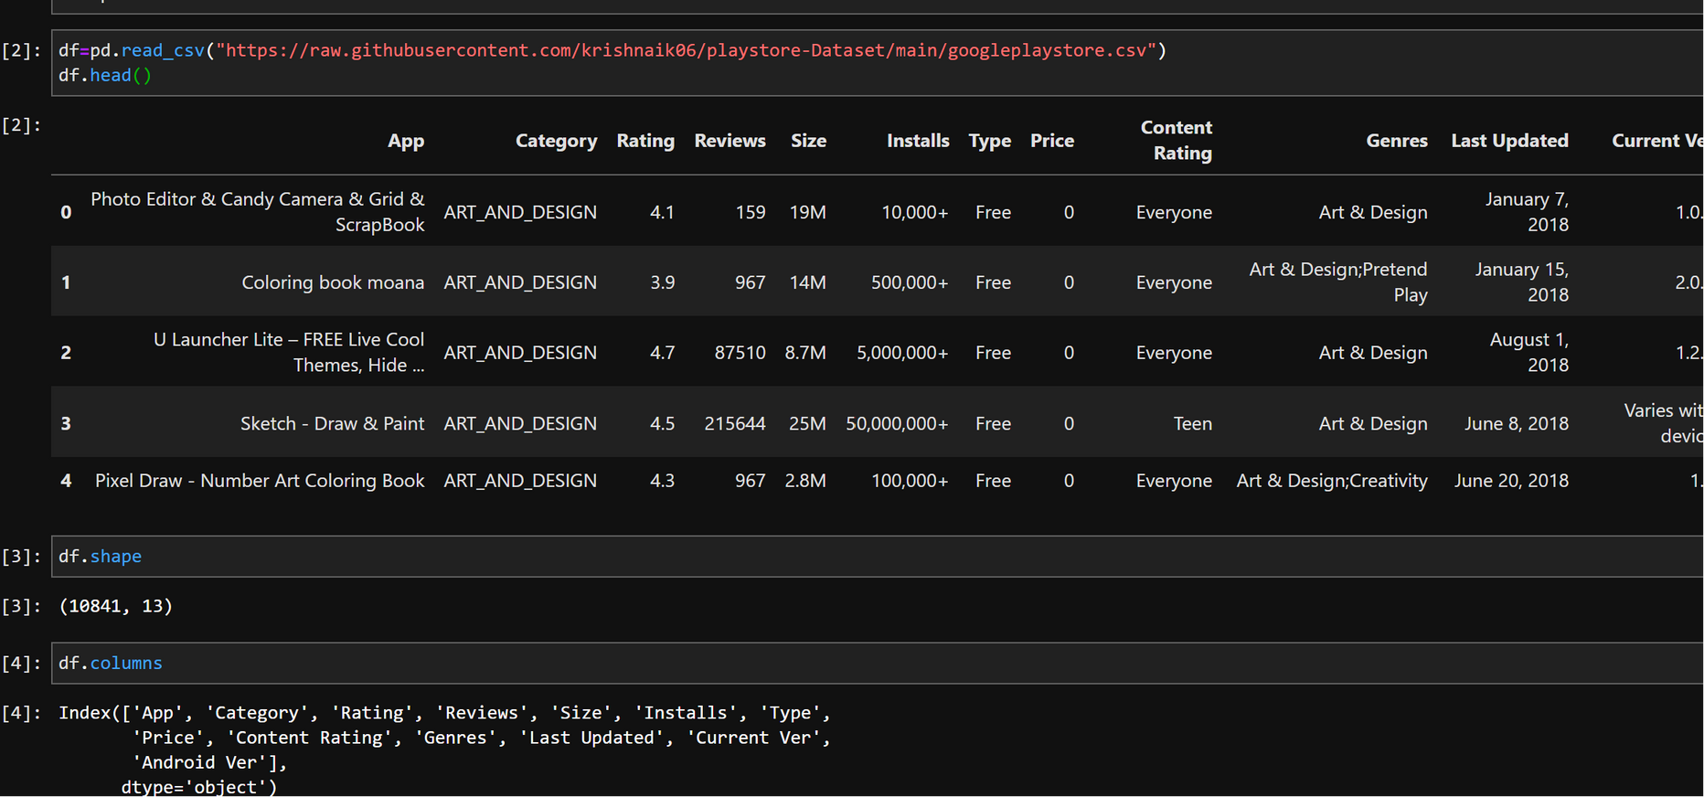
Dataset
https://raw.githubusercontent.com/krishnaik06/playstoreDataset/main/googleplaystore.csv

Slide 7
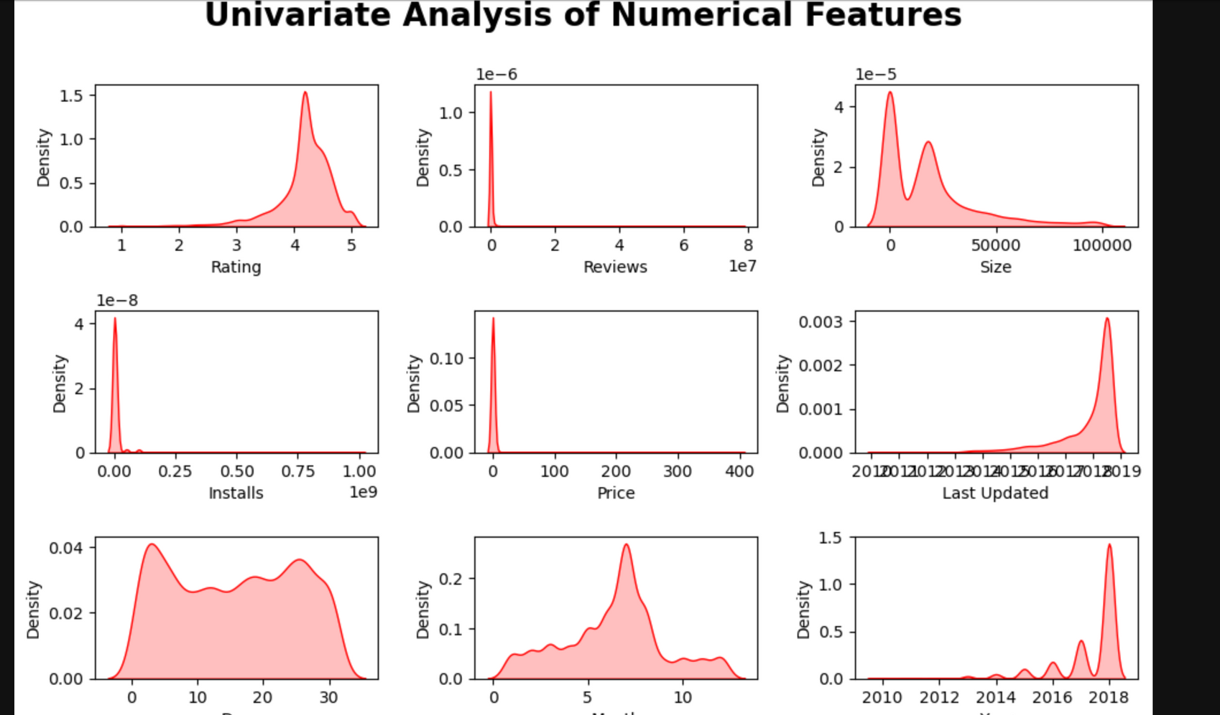
Observation And Analysis
Ratings and Year are Left Skewed
Reviews,Size, Installs and Prices are right skewed
UNIVARIATE ANALYSIS OF NUMERICAL FEATURES

Slide 8
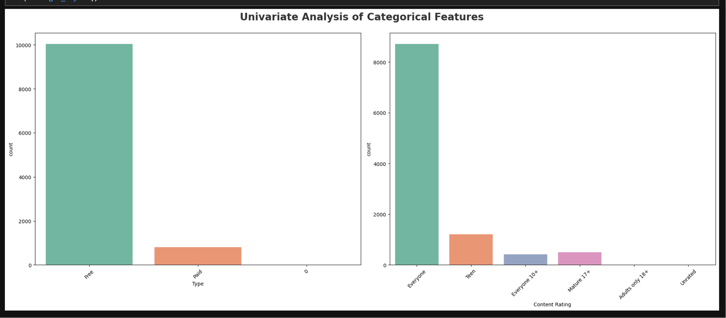
Observation And Analysis
The dataset comprises over 10,000 free apps, contrasted with fewer than 2,000 paid apps.
A significant portion of the apps is designed for a general audience, catering to users of all ages.
Close to 1,000 apps in the dataset are specifically targeted at teenagers.
Additionally, approximately 500 apps are intended for adults aged 18 +.

Slide 9
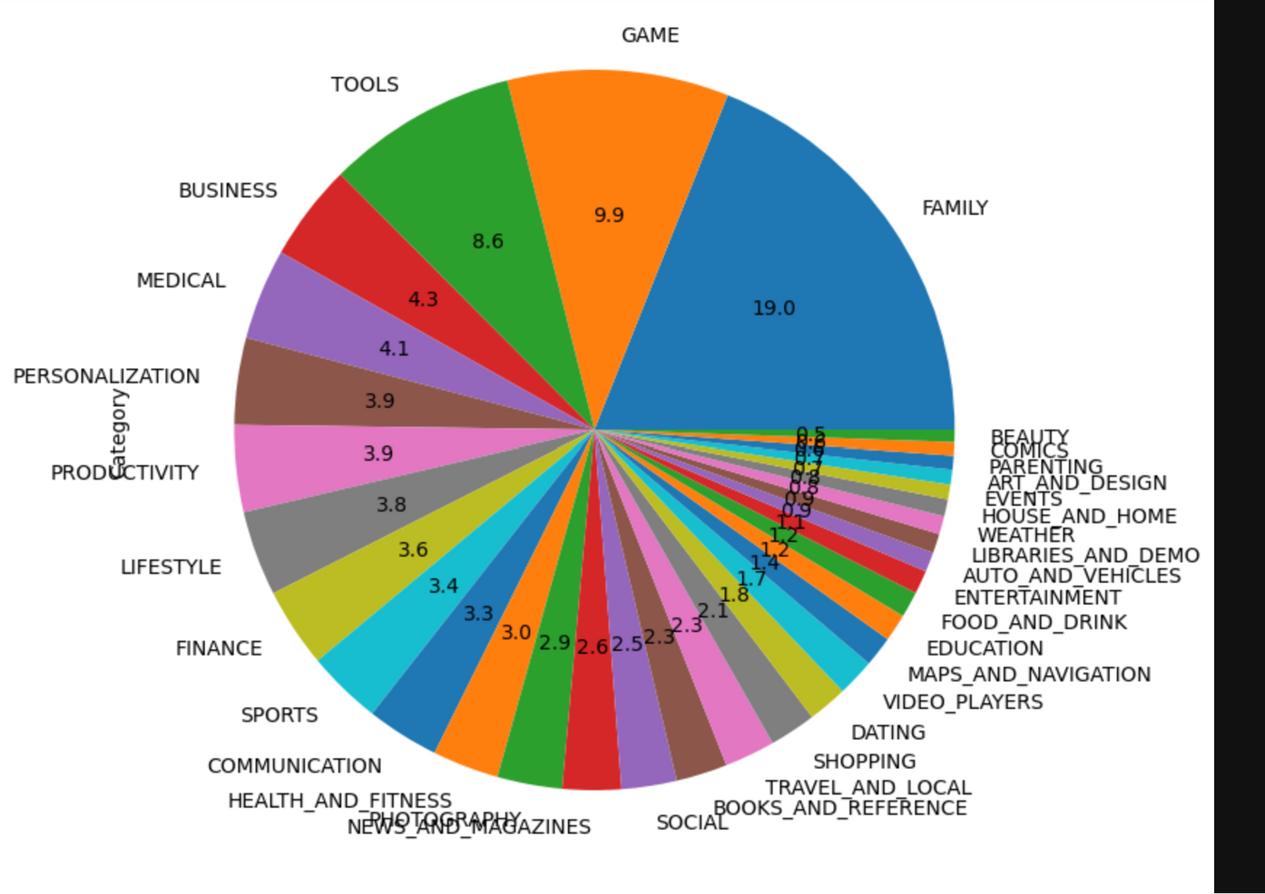
Observation And Analysis
The Play Store features a greater variety of apps in categories such as Family, Games, and Tools.
Categories like Beauty, Comics, Arts, and Weather have a notably smaller presence.

Slide 10
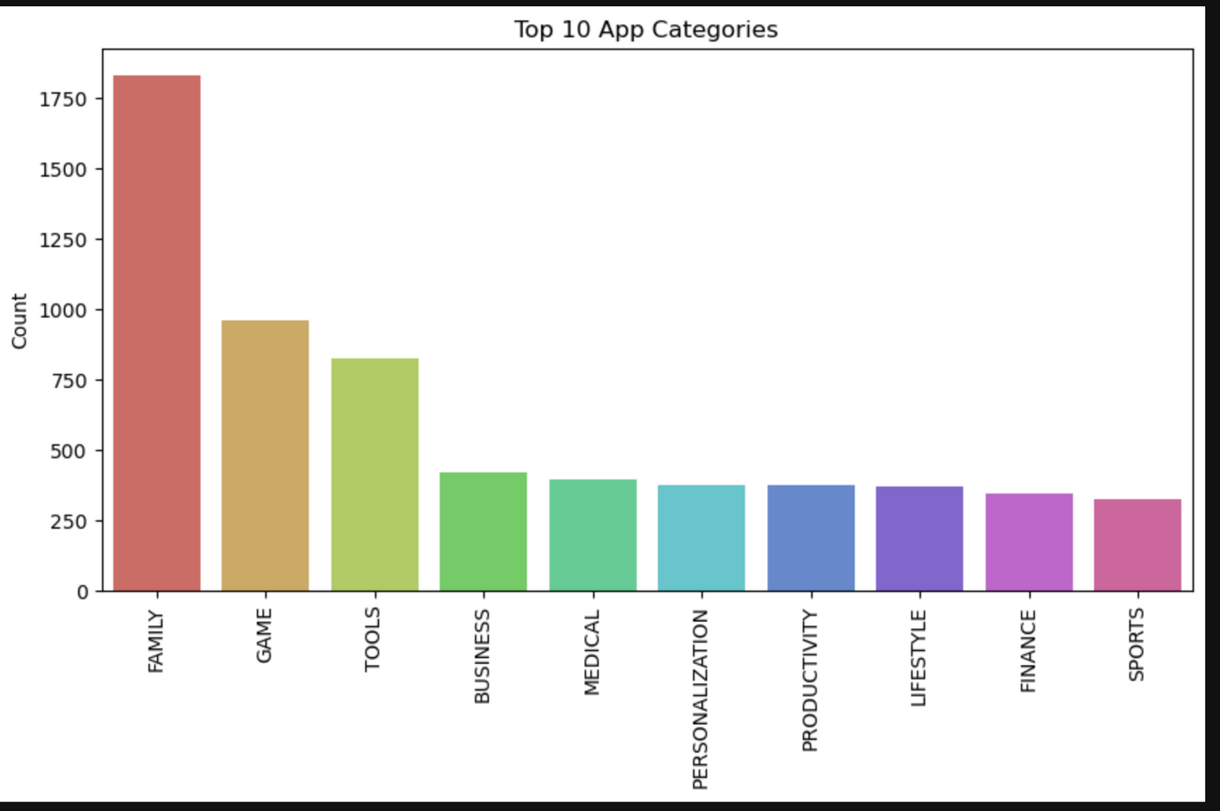
Observation And Analysis
The Family category boasts the highest share of apps, accounting for 18% of the total, followed by the Games category, which encompasses 11% of the apps
Beauty category has the smallest representation, with fewer than 1% of all apps falling into this category.

Slide 11
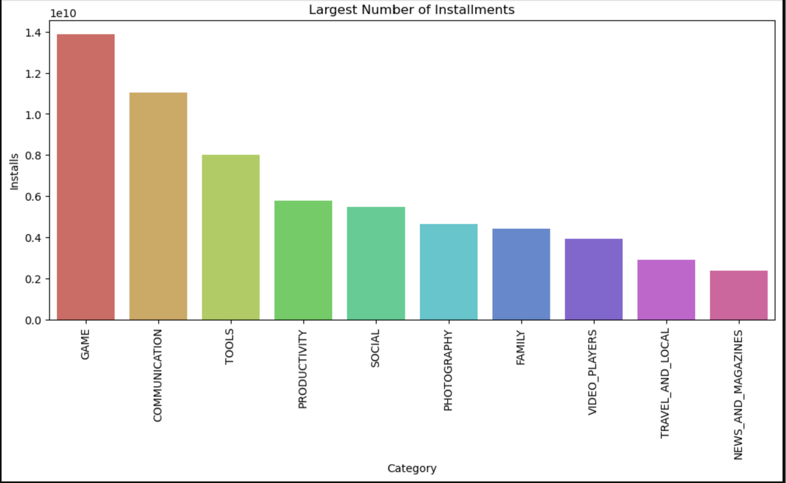
Observation And Analysis
Game apps are installed the most

Slide 12
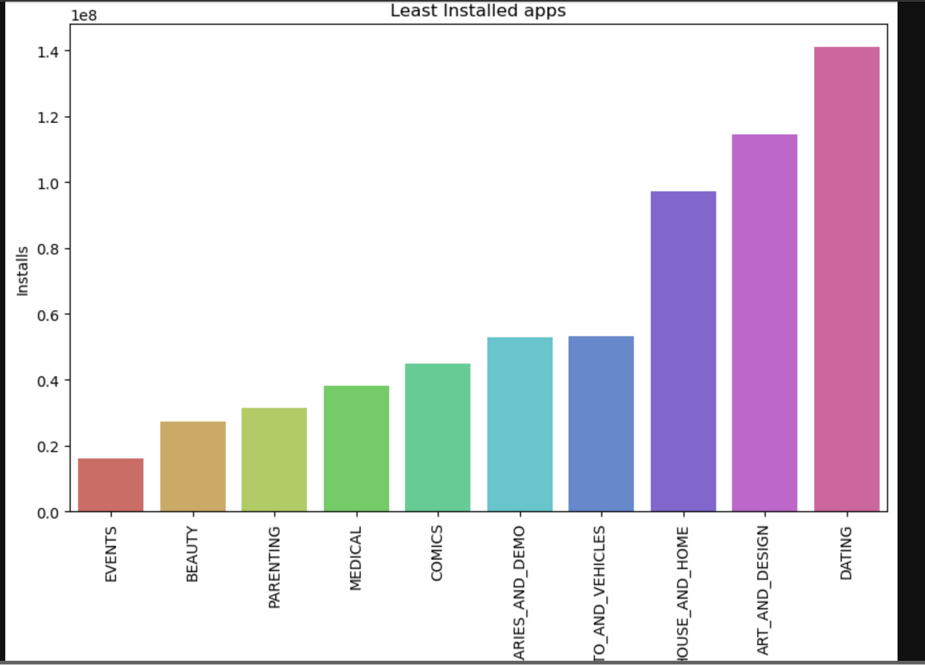
Observation And Analysis
Apps related to events are less in number

Slide 13
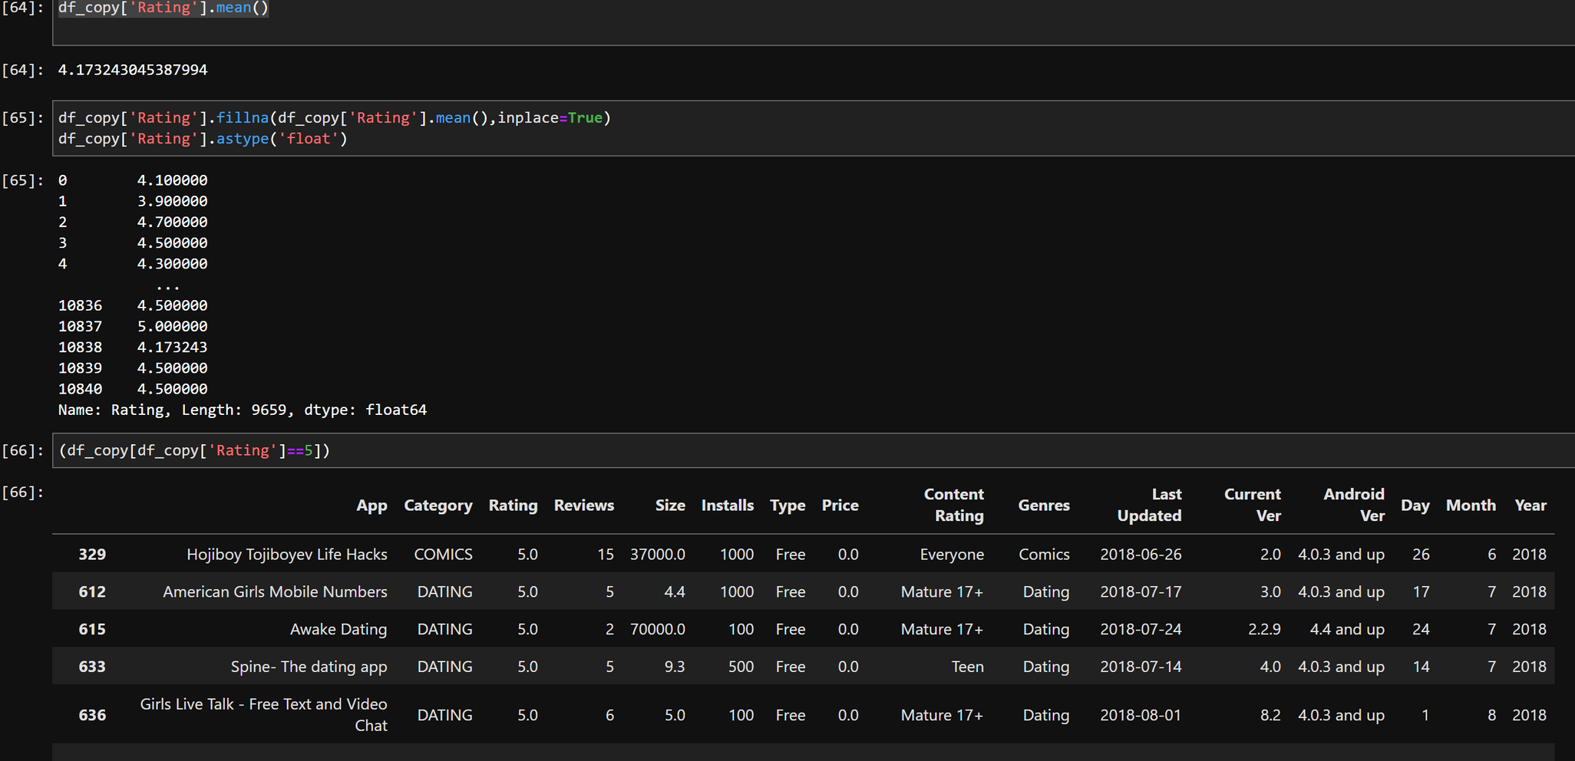
Observation And Analysis
There are 271 apps which are rated as 5 on Google Playstore

Slide 14
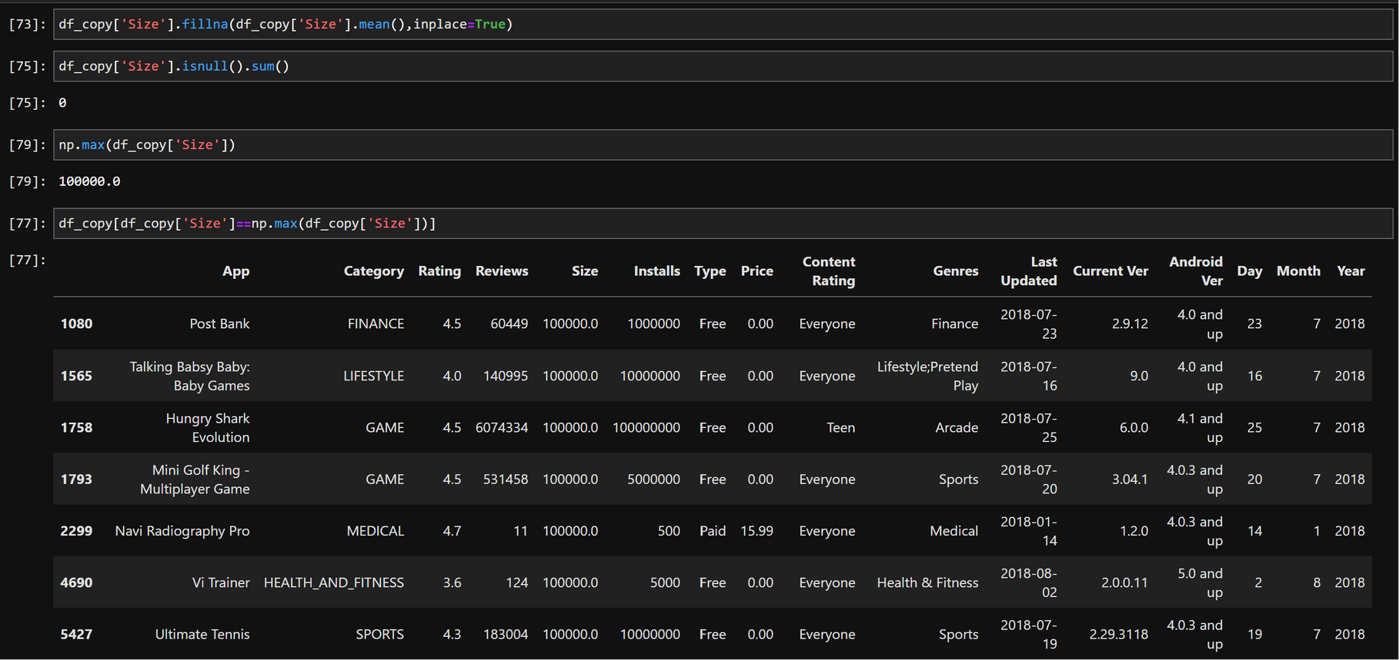
Observation And Analysis
There are 14 apps which has maximum size=100KB

Slide 15
FUTURE SCOPE
After thorough analysis, it has been identified that a significant opportunity for project improvement lies in the implementation of a Classifier Machine Learning model. This addition aims to enhance the project's capabilities in providing more accurate and efficient solutions.

Slide 16
REFERENCE
COURSES
Data Science Masters
Master Machine Learing and Data Science
ProjectLink:https://whitecarpenterfafme.pwskills.app/lab/tree/work/EDA%20ON%20GOOGLE%20PLAYSTORE%20APP.ipynb

Slide 17
THANK-YOU
Any Question ??

